Slide 1


Programming on a Maths Degree to Enhance Teaching, Learning, Assessment, Research and Employability
Dr Stephen Lynch FIMA SFHEA
STEM Ambassador and Speaker for Schools
Department of Computing & Mathematics

Slide 2

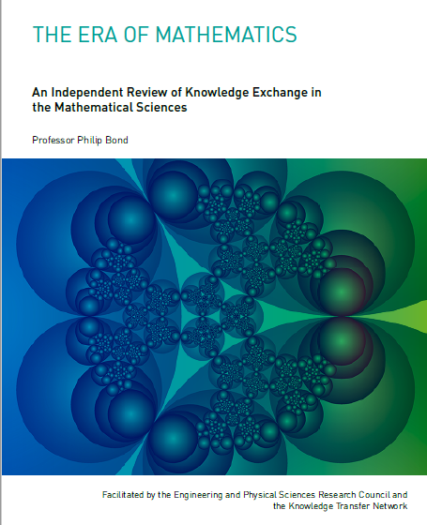
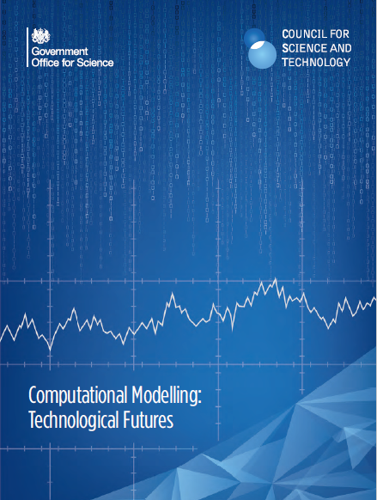
Recommendation 8: The Bond Review (2018)
All Mathematics students should have a working knowledge of at least one programming language.
The Blackett Review (2018)
“Computational modelling is essential to our future productivity and competitiveness, for businesses of all sizes and across all sectors of the economy.“ (Greg Clark MP)

Slide 3

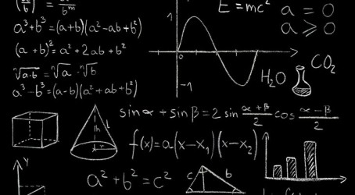
August 2014
A-levels: Maths replaces English as most popular subject in the UK
A-Level Maths pupils: 89000
A-Level English pupils: 85300
A-Level Physics pupils: 36700
A-Level Computing pupils: 4200

Slide 4
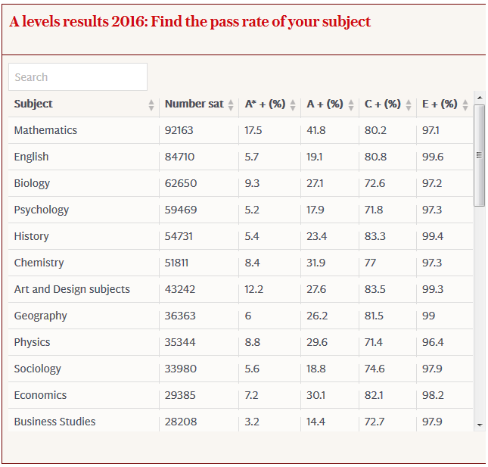

Slide 5
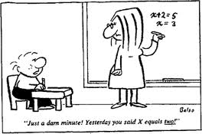
MMU Final Year Undergraduate
Approximate Numbers 2016
Accounting & Finance 420
Business 510
Computing 210
Education 400
Engineering 200
English 250
Healthcare Science 320
Law 260
Mathematics 90
Marketing 300
Sociology 450
Source: NSS Data
Approximate Numbers Nationally
Business 192000
Medicine 190000
Biology 145000
Social Studies 130000
Engineering 99000
Languages 80000
Computing 62000
Law 59000
Mathematics 30000
Source: HESA Press Office
Hold on – yesterday you said x was equal to two!

Slide 6
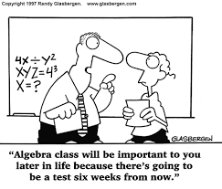
Unfortunate Outcomes of Traditional Mathematics Teaching
Children see learning mathematics as learning procedures to be memorized.
Children have difficulty solving problems that vary from the maths they have memorized, or that require a solution path that is previously unknown.
Children can’t see the point and often ask:
“Why do I need to know this?”

Slide 7
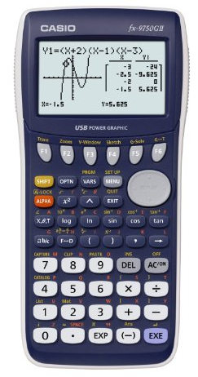
Changes to A-Level Mathematics from 2017
All Exam Boards will cover same content for
A-Level Maths.
The use of technology, in particular mathematical and statistical graphing tools and spreadsheets, must permeate the study of AS and A level mathematics.
Graphical calculators will be compulsory!

Slide 8

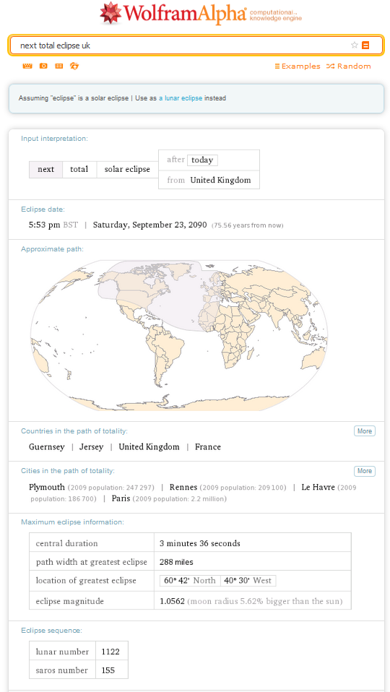
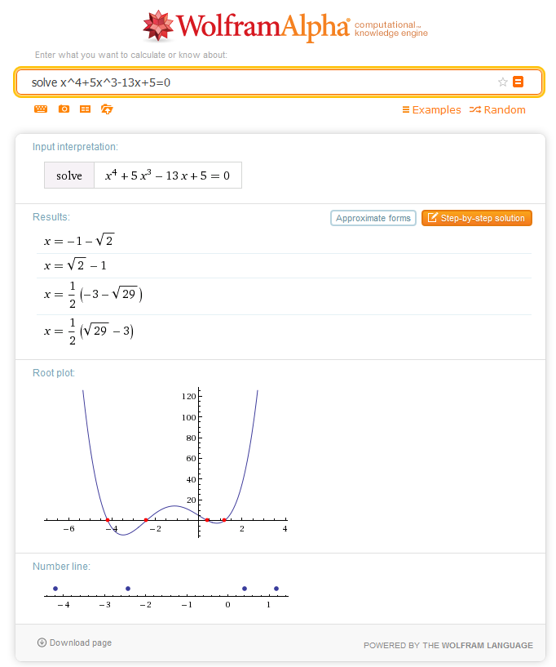
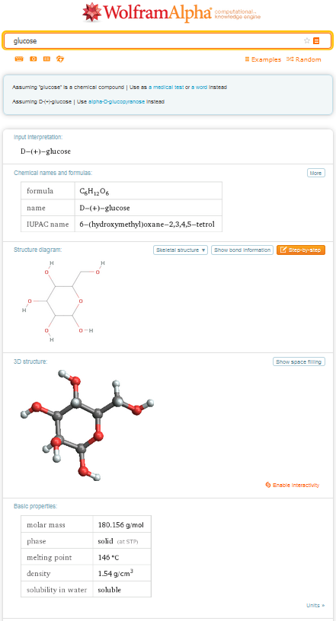
next total eclipse uk
Solve x^4+5x^3-13x+5=0
glucose
Wolfram Alpha would be far cheaper and more fun!

Slide 9
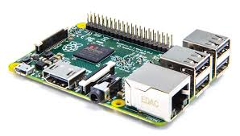
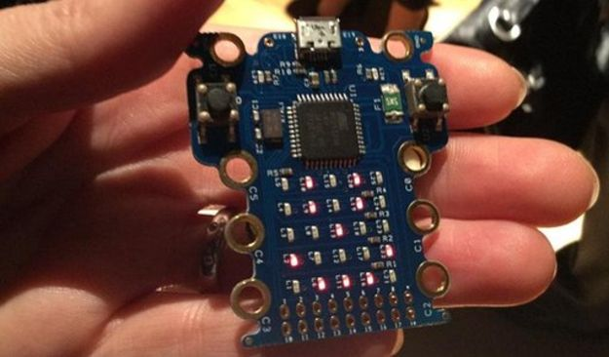
Using Technology to Teach Programming in Schools
Raspberry Pi: developed in the UK by the Raspberry Pi Foundation with the intention of promoting the teaching of basic Computer Science in schools.
Contact: Ben Nuttall
Micro Bit: In September 2015, the BBC was to give ALL Year 7 children in the UK mini-computers as part of the Make it Digital scheme. Actually delivered February 2016!

Slide 10
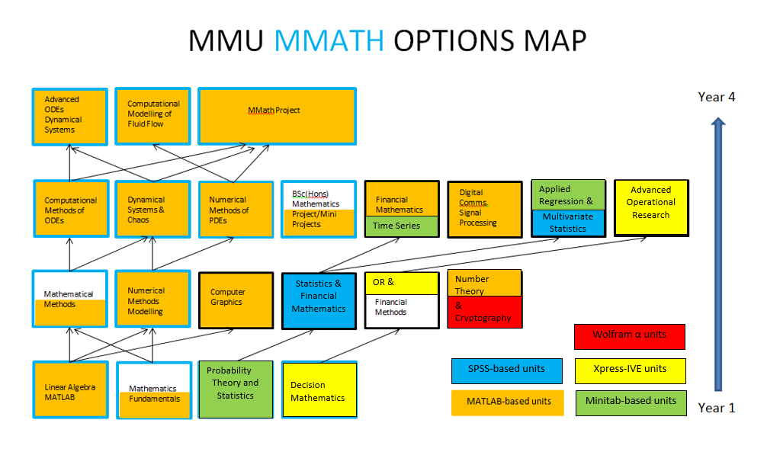

Slide 11




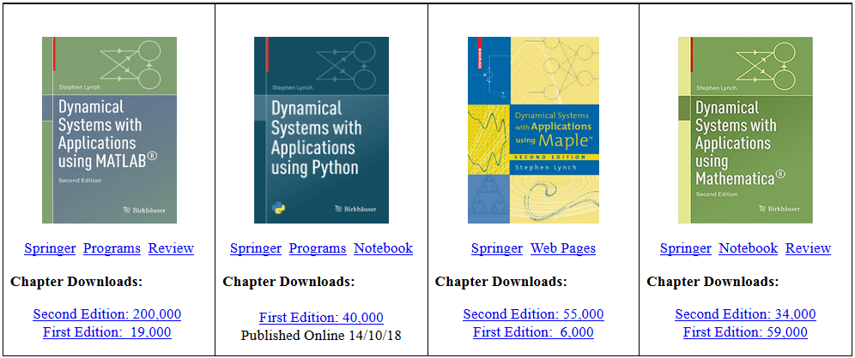

Slide 12
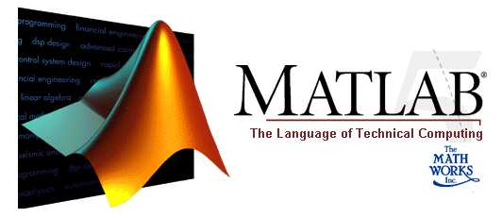
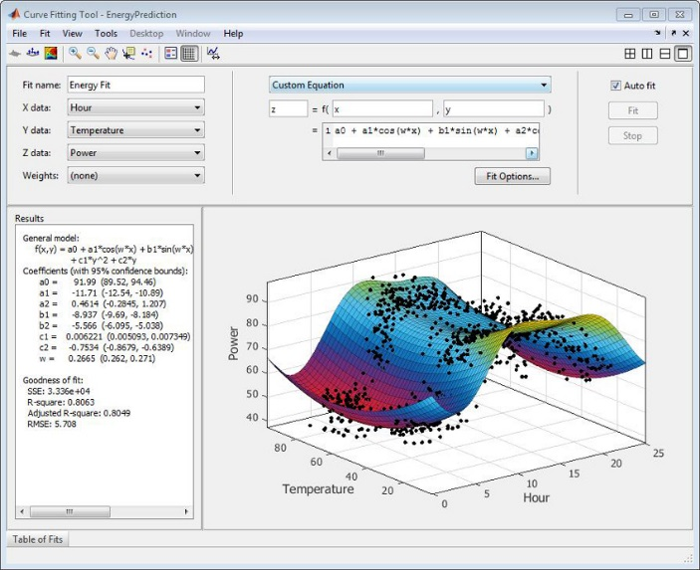
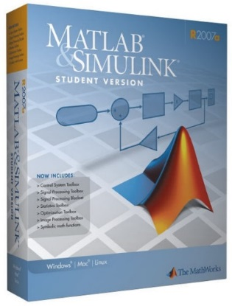
At MMU we have a Faculty site license for MATLAB®
All Maths students at MMU are given a free copy of the Student Edition of MATLAB upon enrolment.
Cost: Approximately £60 each.
Faculty site license costs about £42000.

Slide 13
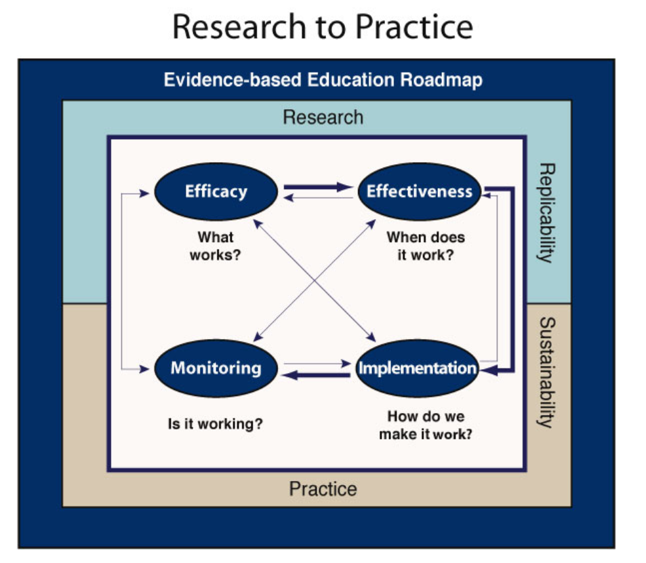
http://winginstitute.org/Roadmap/Wing-Institute-Roadmap/

Slide 14

Using Technology to Enhance Teaching, Learning and Assessment
1. Maths packages enable an interactive, visual approach that gets students to
open up, offer feedback, and ultimately gain a better understanding.
2. Real world problems can be solved.
3. The computer laboratory environment
offers a more intimate experience for
both staff and students.

Slide 15
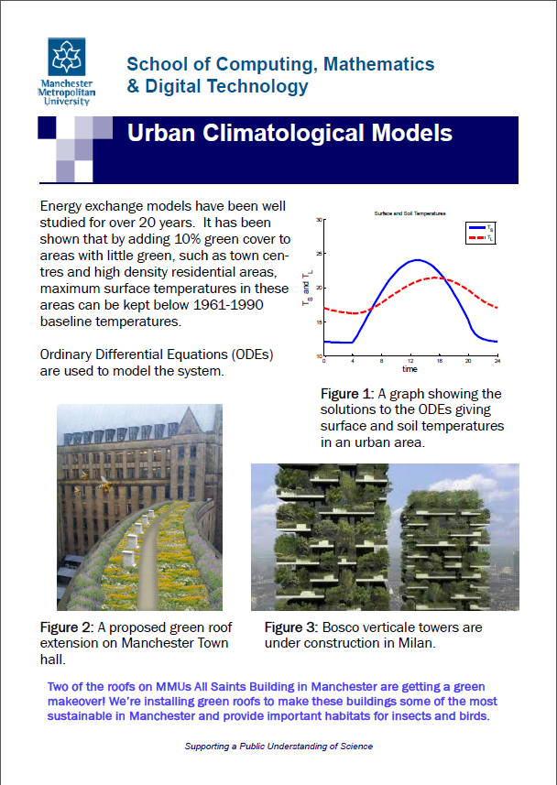
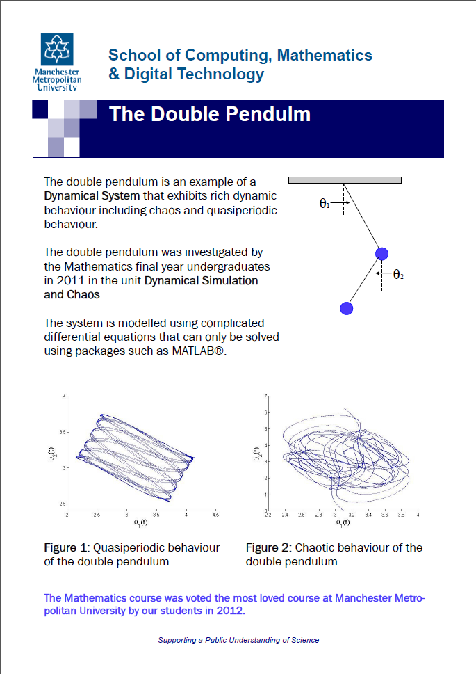
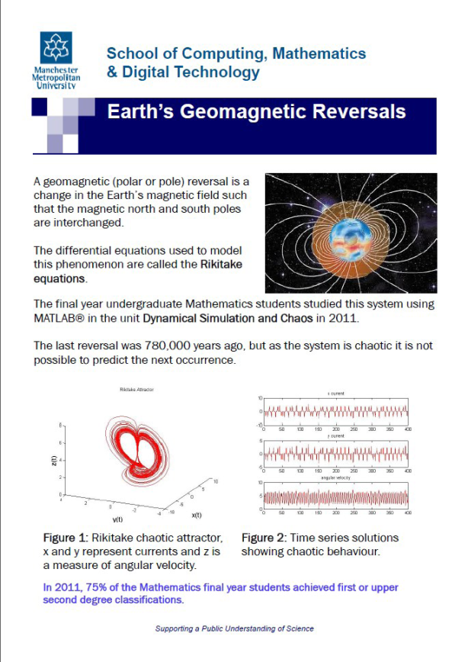
Examples of final year Maths undergraduate coursework

Slide 16
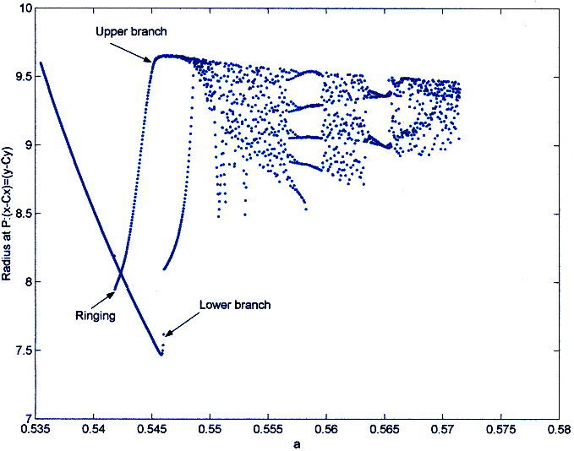
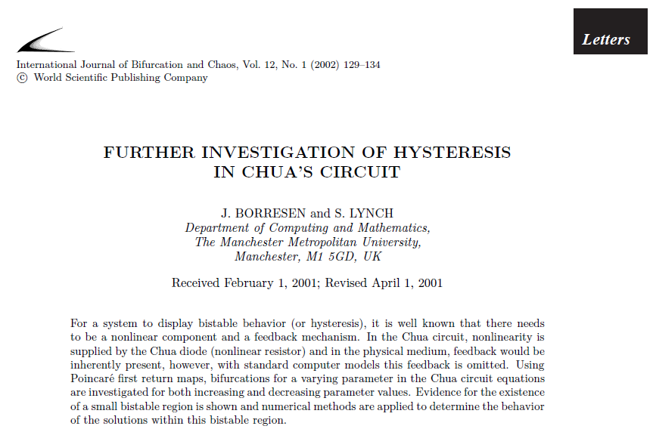
In 2001, MMU undergraduate Jon Borresen did a project with me…
A journal paper was published.
The first hysteresis loop for a Chua circuit.
Plotted with MATLAB.

Slide 17
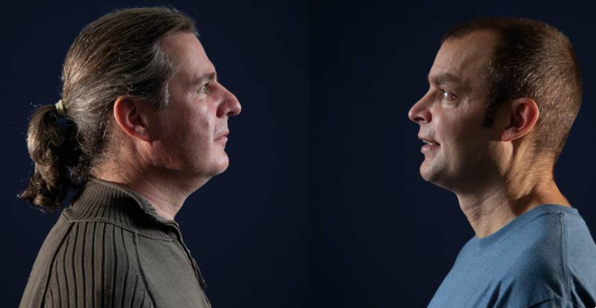
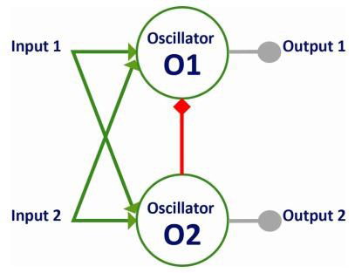
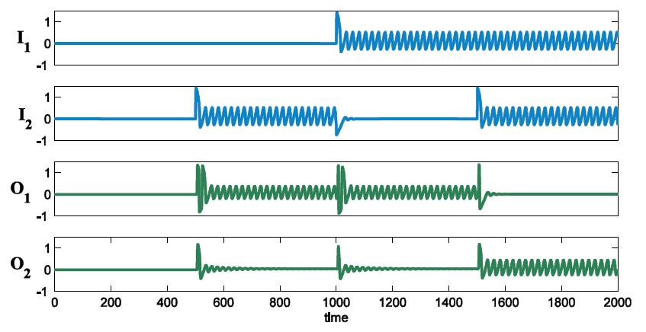
Using Technology to Enhance Research
http://www.researchgate.net/
The Binary Oscillator Half-Adder
(UK and US Patents).
Input and output of an oscillator half-adder.
Simulation run in MATLAB®.

Slide 18
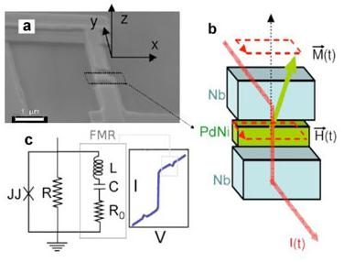
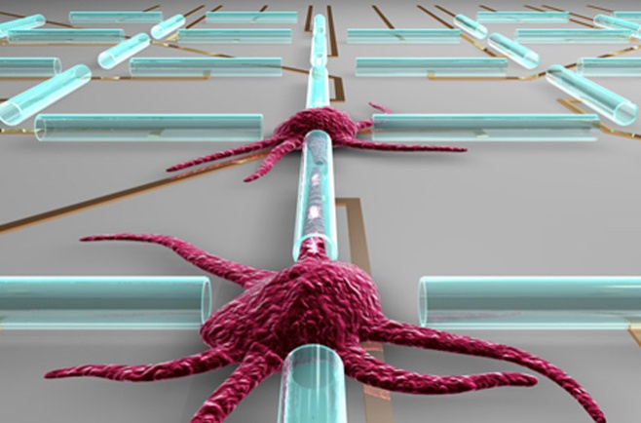
We are pursuing two avenues of research:
Building superfast, low power computers using
super-cooled Josephson junctions (JJs). A JJ acts
like a biological neuron but pulses 100 million
times faster and can be built on the nano-scale.
We are also attempting to build the world’s first
assay for neuronal degradation. The device will
be used to test drugs for neurological conditions
such as Alzheimer’s disease, Parkinson’s disease
and epilepsy.

Slide 19
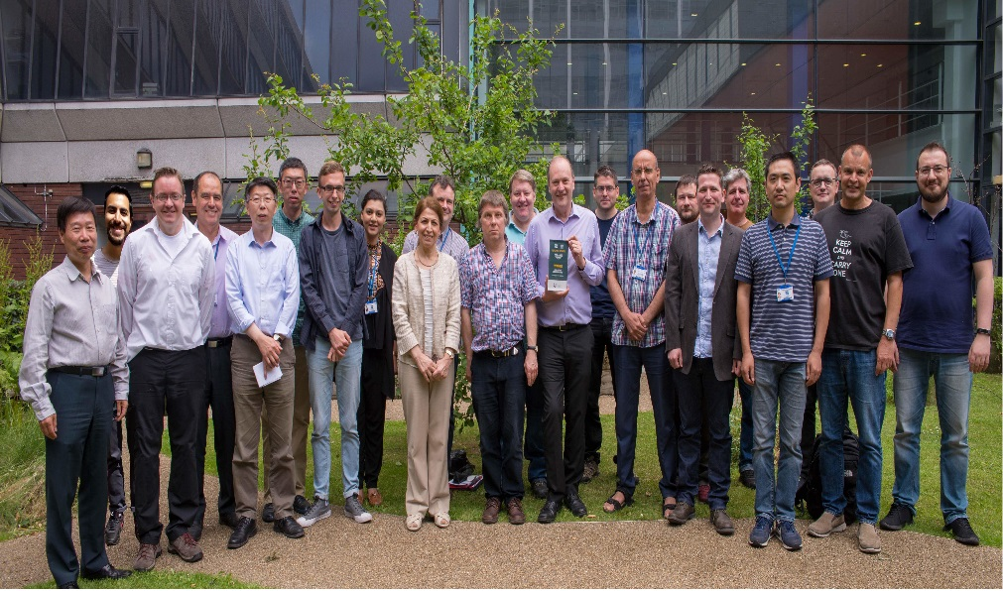

Mathematics at MMU was voted "Best Overall Course" by our students in 2012 and 2018. We were also shortlisted in 2011, 2013, 2014 and 2019!

Slide 20
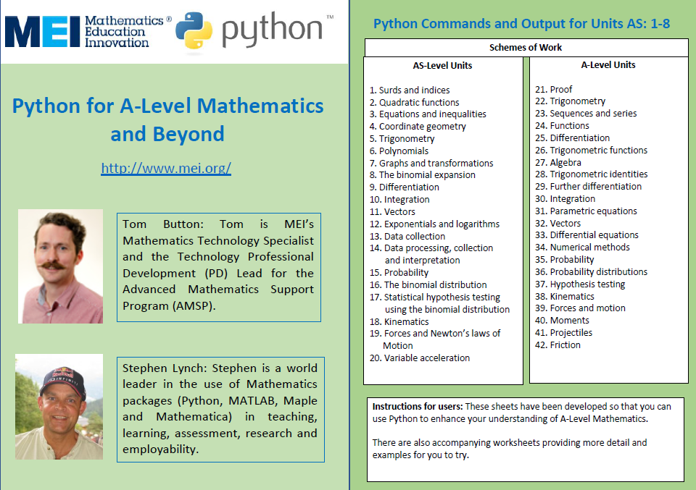

Slide 21





Thank you! Are there any questions?

