Slide 1
Nooblab and MATLAB: Teaching programming to maths and computing students.
James Denholm-Price and Paul Neve
School of Computer Science & Mathematics
Kingston University
IMA Higher Education Teaching and Learning Workshop 2018/2019: Programming in the Undergraduate Mathematics Curriculum, 27th June 2019,
Middlesex University

Slide 2
Overview/Introduction
What we do at KUL
Nooblab
Does it “work” for maths and computer science students?
Can we extend it?
Can we share it?

Slide 3
What we do is fairly traditional
Maths:
  Introductory core “computational maths” in 1st year, aiming at getting students into programming MATLAB, with a sprinkling of Maple as a “calculus calculator”
    It was FORTRAN90 before 2016 ☺
  Option “mathematical modelling” with ⅓ MATLAB in year 2 (on its last legs…)
  Extinct option “computational maths 2” in year 3 with F90, MATLAB, algorithms etc.
Computer Science:
  Programming 1
    Nooblab: Carol, Python, JavaScript, Java, OO Java (main path)
    Nooblab: Carol, Python, Web (HTML→PHP), Java, JavaScript (slower path)
  Programming 2 – depth (Java)
  Programming 3 – breadth (Spring, Web APIs, MATLAB, Python, Raspi, .Net)
Notes:
“Computer Science” includes
Prog3 includes more Java, Java Spring, Web APIs (Google Maps typically), MATLAB + Python + Raspi, .Net

Slide 4
Nooblab
Neve, Hunter, Livingstone, and Orwell, (2012) “NoobLab: An intelligent learning environment for teaching programming.”
In Proc. of the 2012 IEEE/WIC/ACM International Joint Conferences on Web Intelligence and Intelligent Agent Technology-Volume 03 (pp. 357-361). IEEE Computer Society.
Is fairly traditional according to Luxton-Reilly et. al (2018) “Introductory programming: a systematic literature review”
But with some features for detecting/deterring programming that all-in-one environments can do straightforwardly…
And with two “affordances” (Carol/blocks and text-based in the same environment for CS, or Nooblab/MATLAB for MA) which we hope is a strength (e.g. Lewis, 2010, “How programming environment shapes perception, learning and goals: logo vs. scratch.”)
Notes:
Luxton-Reilly, A., Albluwi, I., Becker, B.A., Giannakos, M., Kumar, A.N., Ott, L., Paterson, J., Scott, M.J., Sheard, J. and Szabo, C., 2018, July. Introductory programming: a systematic literature review. In Proceedings Companion of the 23rd Annual ACM Conference on Innovation and Technology in Computer Science Education (pp. 55-106). ACM.
Lewis, C.M., 2010, March. How programming environment shapes perception, learning and goals: logo vs. scratch. In Proceedings of the 41st ACM technical symposium on Computer science education (pp. 346-350). ACM.

Slide 5
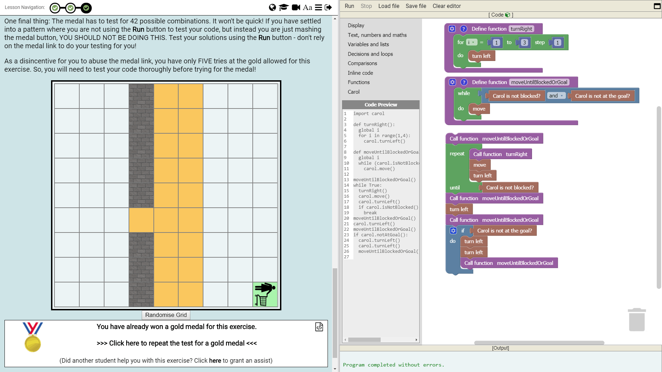
Programming 1 (30 credits, Level 4)
Uses Nooblab exclusively for language skills development and assessment
Starts with a “blocks” based visual programming tool akin to others like Scratch, Bluefoot etc…
  Python syntax
  by “stealth”

Slide 6
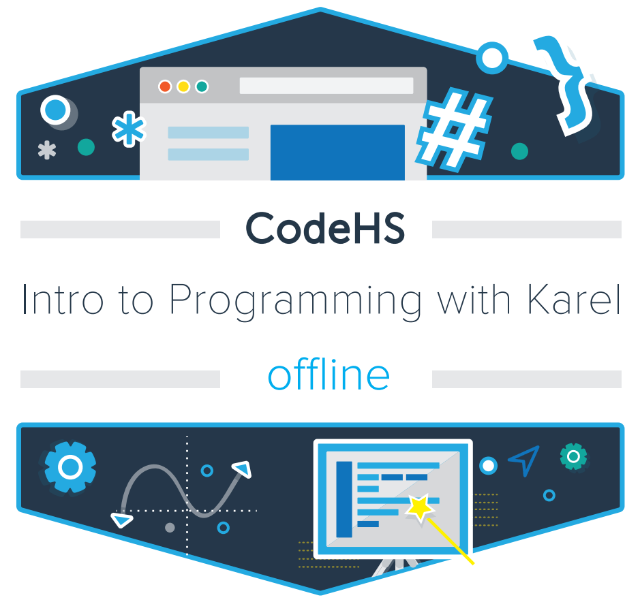
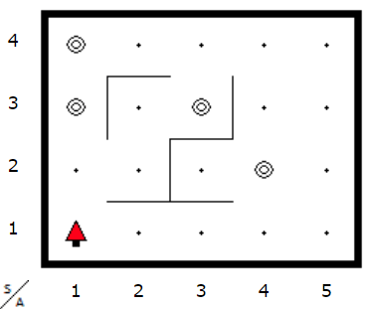
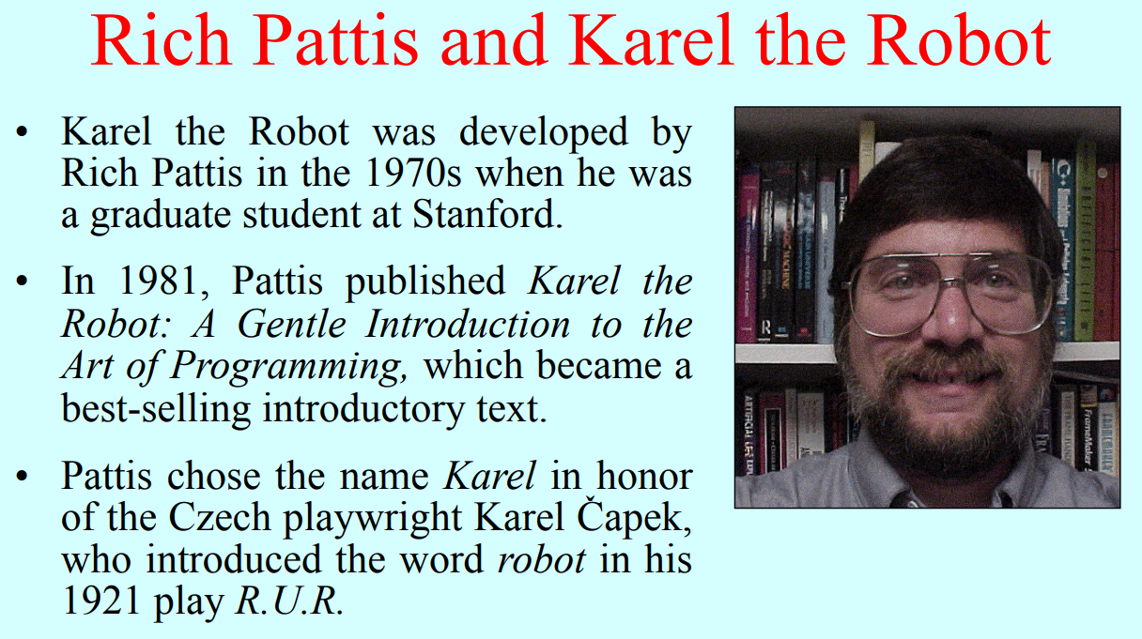
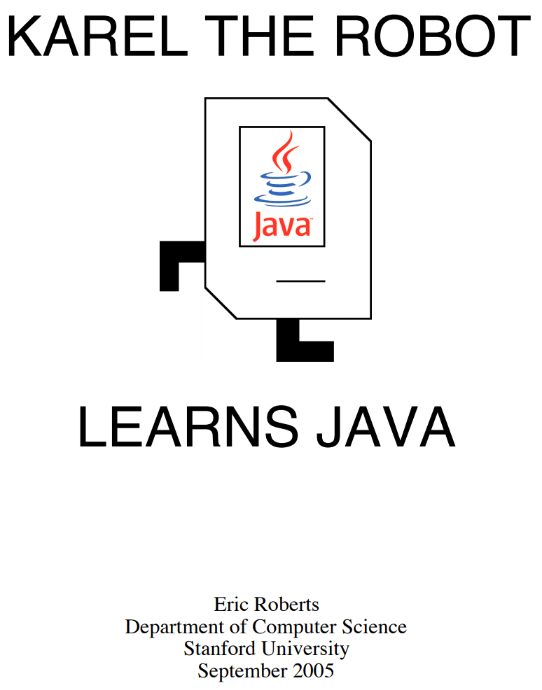

Programming 1 (30 credits, Level 4)
… with a robot called Carol … named after Richard Pattis’ Karel
(but we’re not the only imitators people to pay homage…)
“Karel J. Robot: A gentle introduction to the art of object-oriented programming in Java.”
Bergin, J., Stehlik, M., Roberts, J. and Pattis, R., (2005)
Notes:
https://web.stanford.edu/class/cs106j/lectures/02-Programming-In-Karel/02-Programming-In-Karel.pdf
Bergin, J., Stehlik, M., Roberts, J. and Pattis, R., 2005. Karel J. Robot: A gentle introduction to the art of object-oriented programming in Java. Redwood City: Dream Songs.

Slide 7
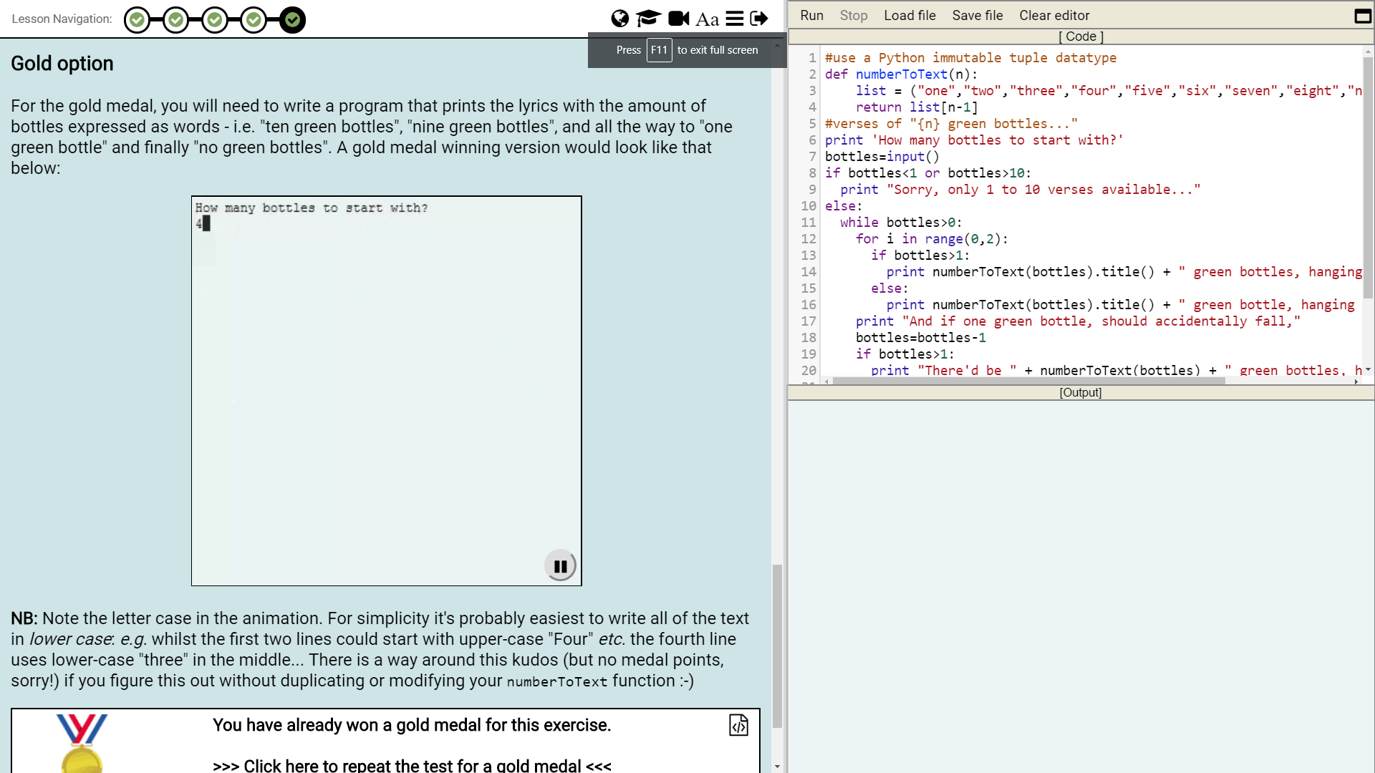
Programming 1 (30 credits, Level 4)
Travels through
  Python sampler
  A simple web-based MVC-style kit to give easy “wins” to those stalled in code
  Pure JavaScript and then DOM
  Basic Java syntax
  Finally OO Java

Slide 8
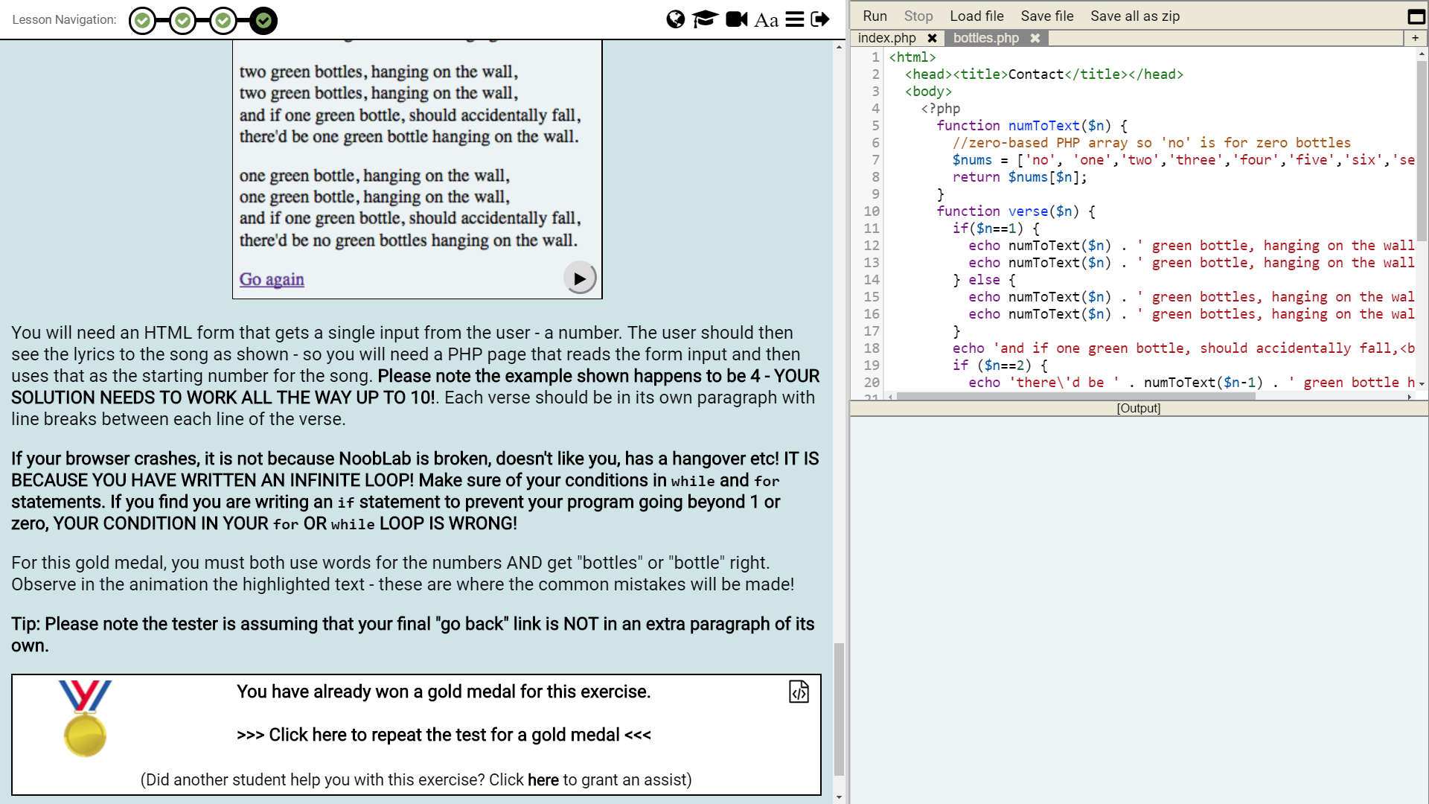
Programming 1 (30 credits, Level 4)
Travels through
  Python sampler
  A simple web-based MVC-style kit to give easy “wins” to those stalled in code
  Pure JavaScript and then DOM
  Basic Java syntax
  Finally OO Java

Slide 9
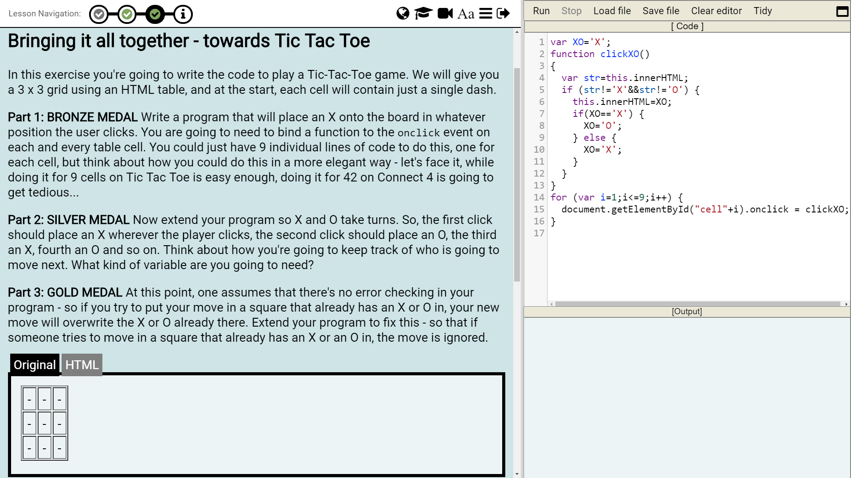
Programming 1 (30 credits, Level 4)
Travels through
  Python sampler
  A simple web-based MVC-style kit to give easy “wins” to those stalled in code
  Pure JavaScript and then DOM
  Basic Java syntax
  OO Java

Slide 10
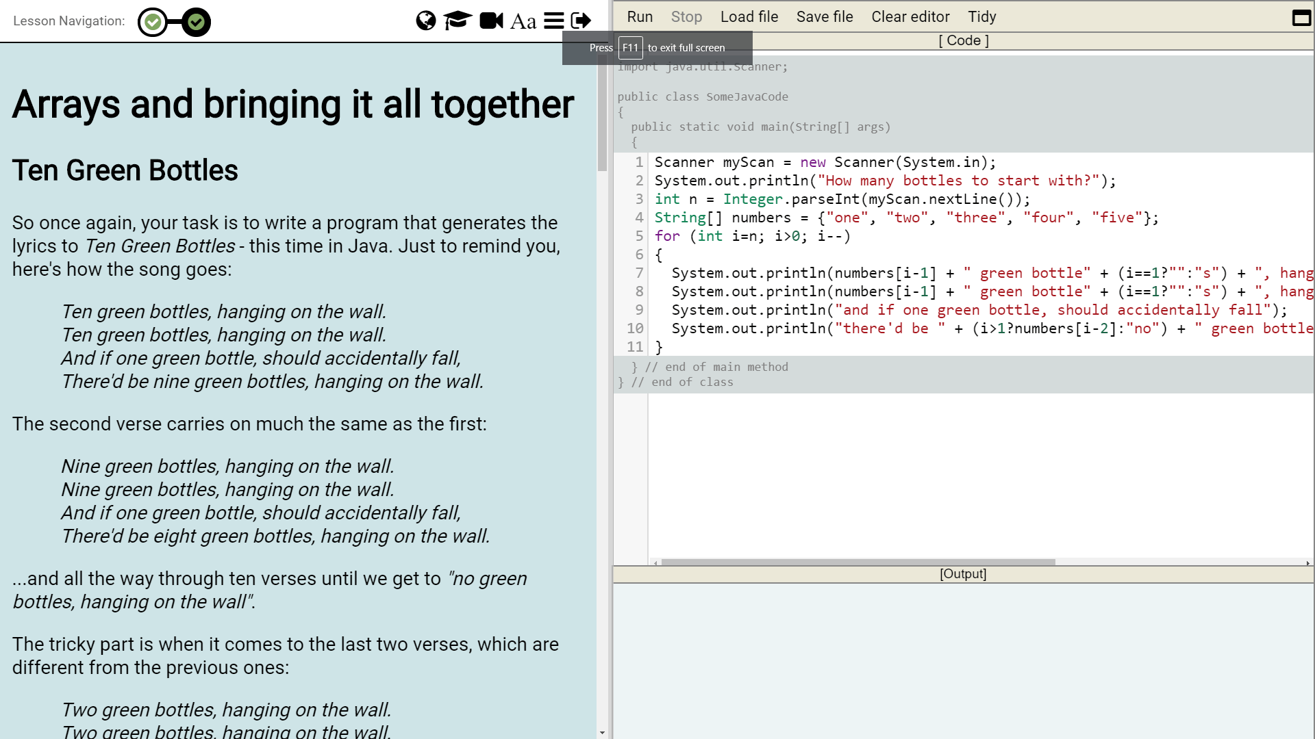
Programming 1 (30 credits, Level 4)
Travels through
  Python sampler
  A simple web-based MVC-style kit to give easy “wins” to those stalled in code
  Pure JavaScript and then DOM
  Basic Java syntax
  OO Java

Slide 11
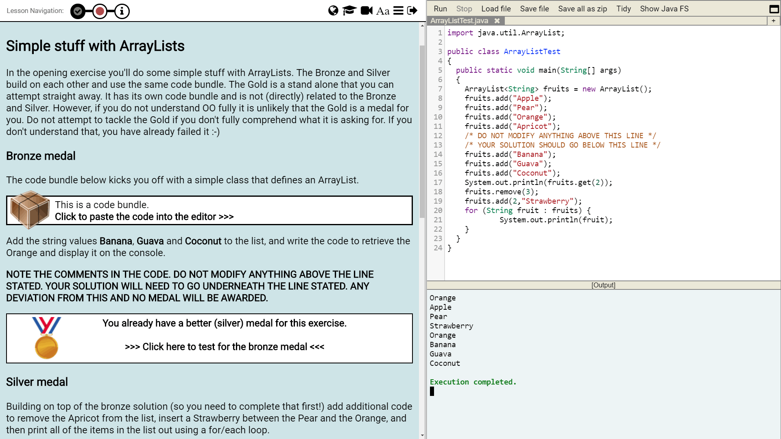
Programming 1 (30 credits, Level 4)
Travels through
  Python sampler
  A simple web-based MVC-style kit to give easy “wins” to those stalled in code
  Pure JavaScript and then DOM
  Basic Java syntax
  OO Java

Slide 12
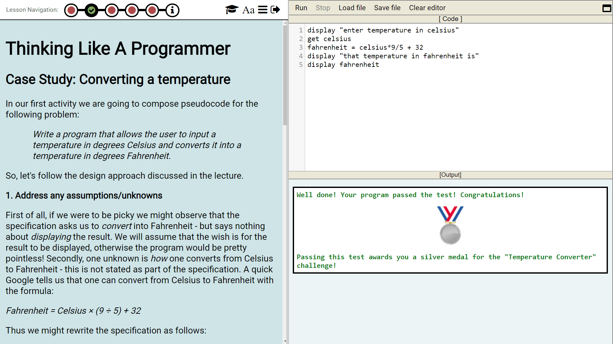
Computational maths (prior to 2018)
The maths module just uses Nooblab for “thinking like a programmer” tasks – getting over initial hurdles of code, concepts and simple syntax
Prior to 2018 we used a pseudocode language exclusively – no visual programming tool:

Slide 13
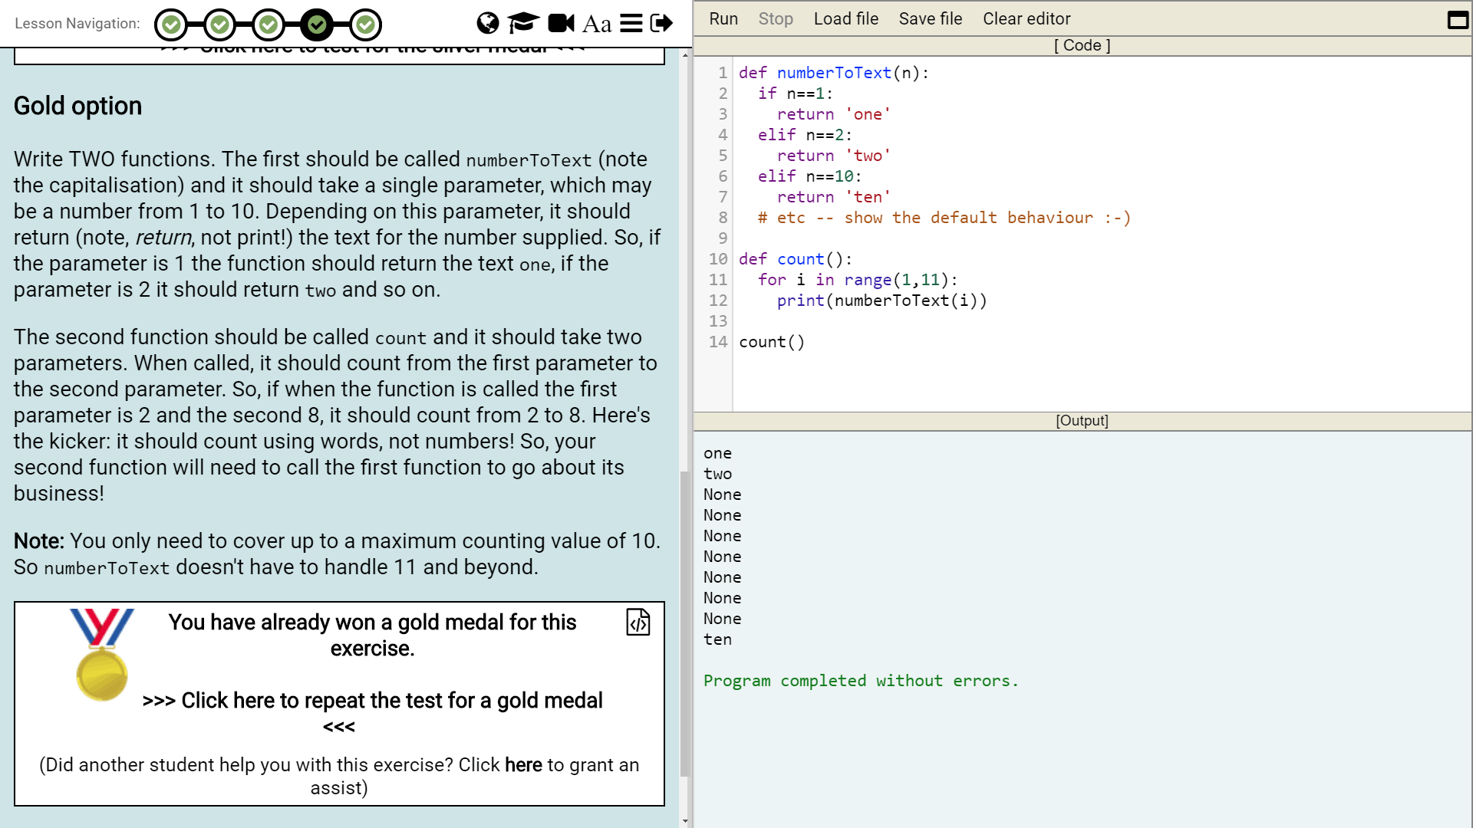
Computational maths (2018)
This year we adopted Carol, sharing with CS so the two cohorts mixed … starting with “blocks” code followed-by a Python text-based “bridge” after 3 weeks intended to give a clear segue into MATLAB
  (We ought to have used Octave with Nooblab instead of Python but CS wan Python not MATLAB … and TBH we didn’t have manpower to implement Octave-in-Nooblab 😐 )
Notes:
CS & maths mixed in programming for 5-6 weeks, but they were together in “professional environments” all year so we felt it was also useful to motivate some sharing and working-together on “subject-specific skills” at the same time they were being introduced to working together on “soft” or “employability” skills…

Slide 14
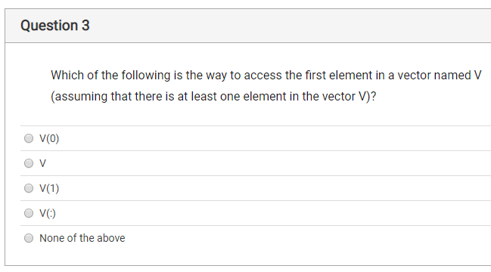
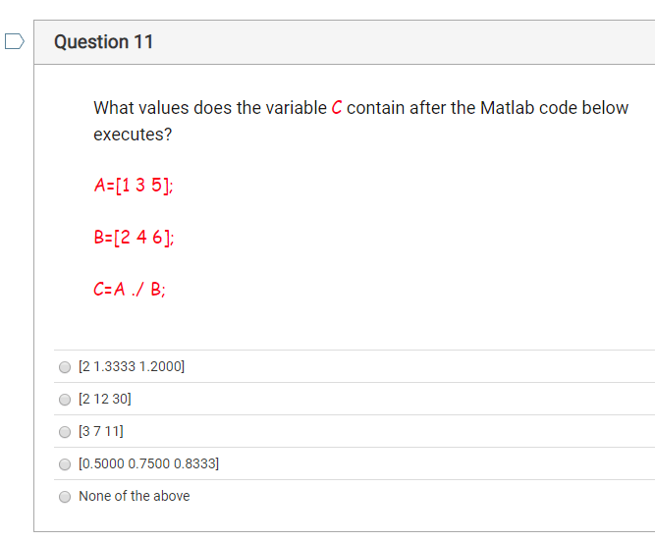
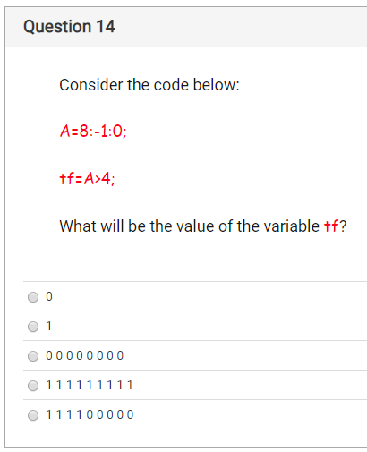
MATLAB prior to 2018 (and F90 prior to 2016)
Traditional 1h lecture, 2h workshop/problem delivery
Assessed through coursework (workshop problems) and online quizzes (mix of Bloom’s knowledge and apply)

Slide 15
MATLAB from 2018
3h lecture/workshop – short bursts of talk, lots of exercises
1h problem-solving session – more “mathsy” problems:
  10 Green Bottles – transfer Python to MATLAB
  Guess an integer in [1,100] – explore code & bisection
  Collatz conjecture – loops & “proof” in maths problems
assessed summatively with coursework (“mathsy” problems as bonus) and online quizzes in formative mode
Notes:
“Guessing games” prompts discussion of loops, randomness, strategy, bisection
“Collatz” gives us a platform for introducing conjectures, proof, unsolved problems, illustrated in MATLAB (and for more advanced students we discuss number representation, MATLAB’s types, accuracy and rounding/overflow etc.)

Slide 16
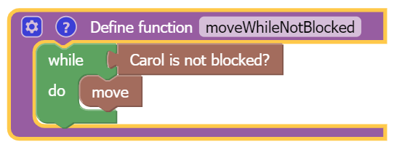
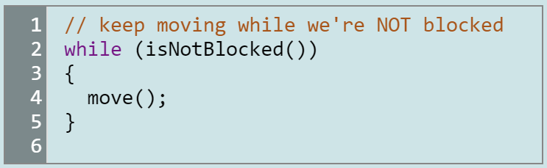
2015/6/7 vs. 2018
This year we adopted Carol, sharing with CS so the two cohorts mixed … “blocks” introduction with a Python text-based “bridge” after 3 weeks intended to give a clear segue into MATLAB
Is one superior to the other? Some concern that the visual “blocks” environment might be too far removed from text-based environments like MATLAB …

Slide 17
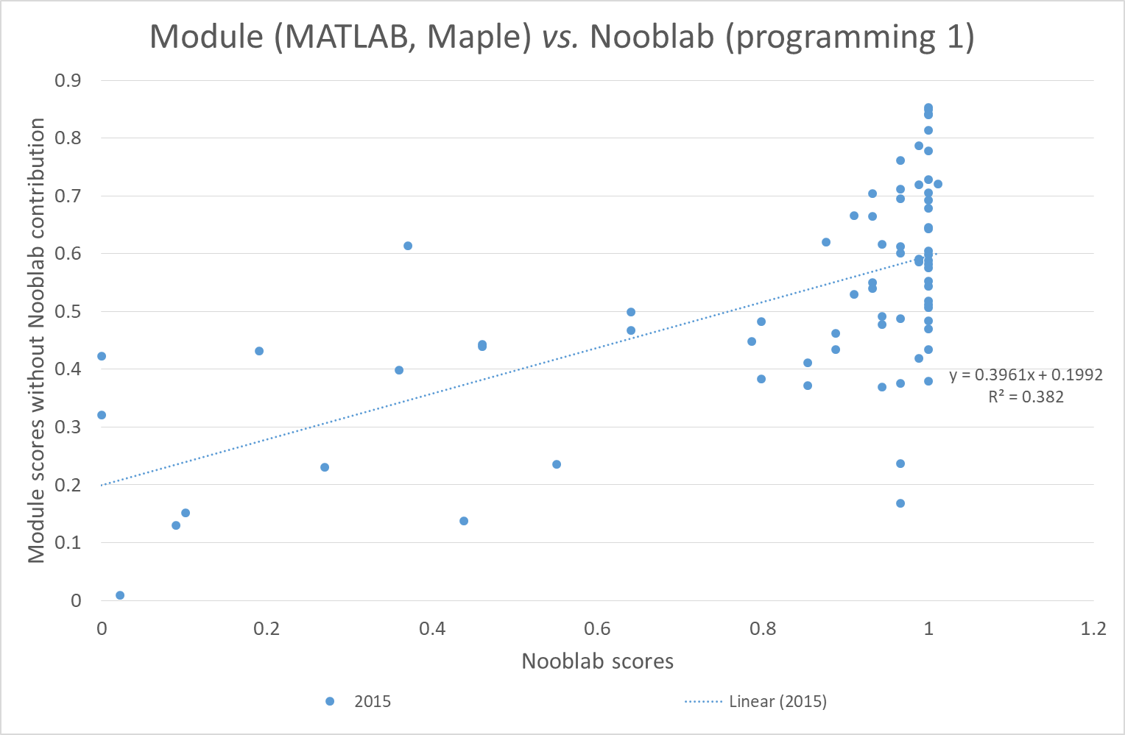
Text-based Nooblab (Carol vs. non-Carol)
2015 (n=74)
  1st run of this module, bit of a mess but there is a relationship between preparation and programming (coursework)
  100% on text-based Nooblab is not a perfect predictor of success…

Slide 18
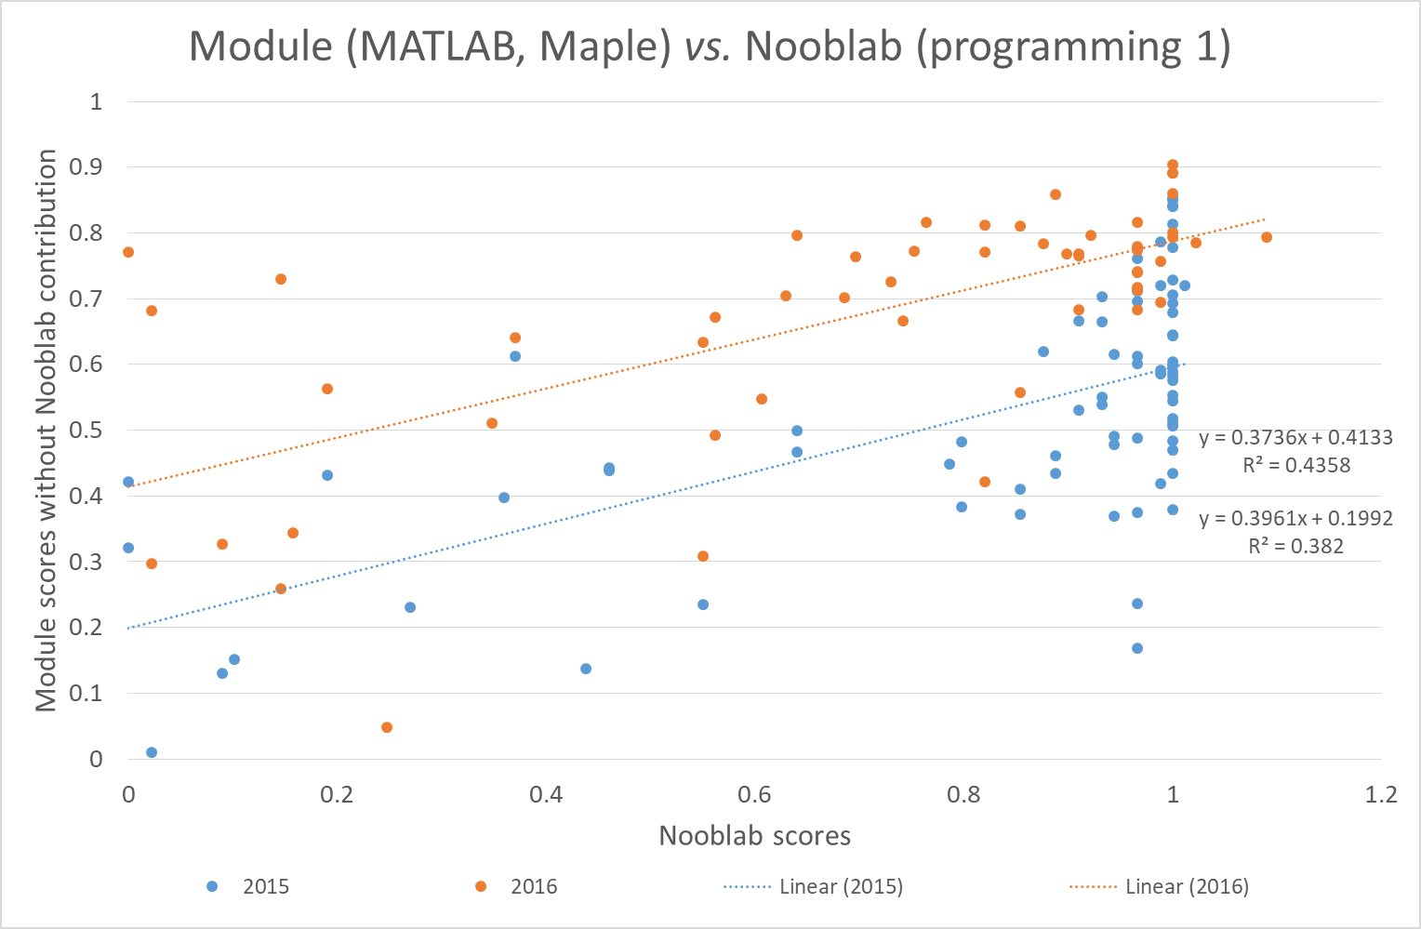
Text-based Nooblab (Carol vs. non-Carol)
2015 (n=74)
2016 (n=55)
  Similar pattern, average module marks are up
  (we got better at running things?)
  This time around everyone with good text-based Nooblab does well.

Slide 19
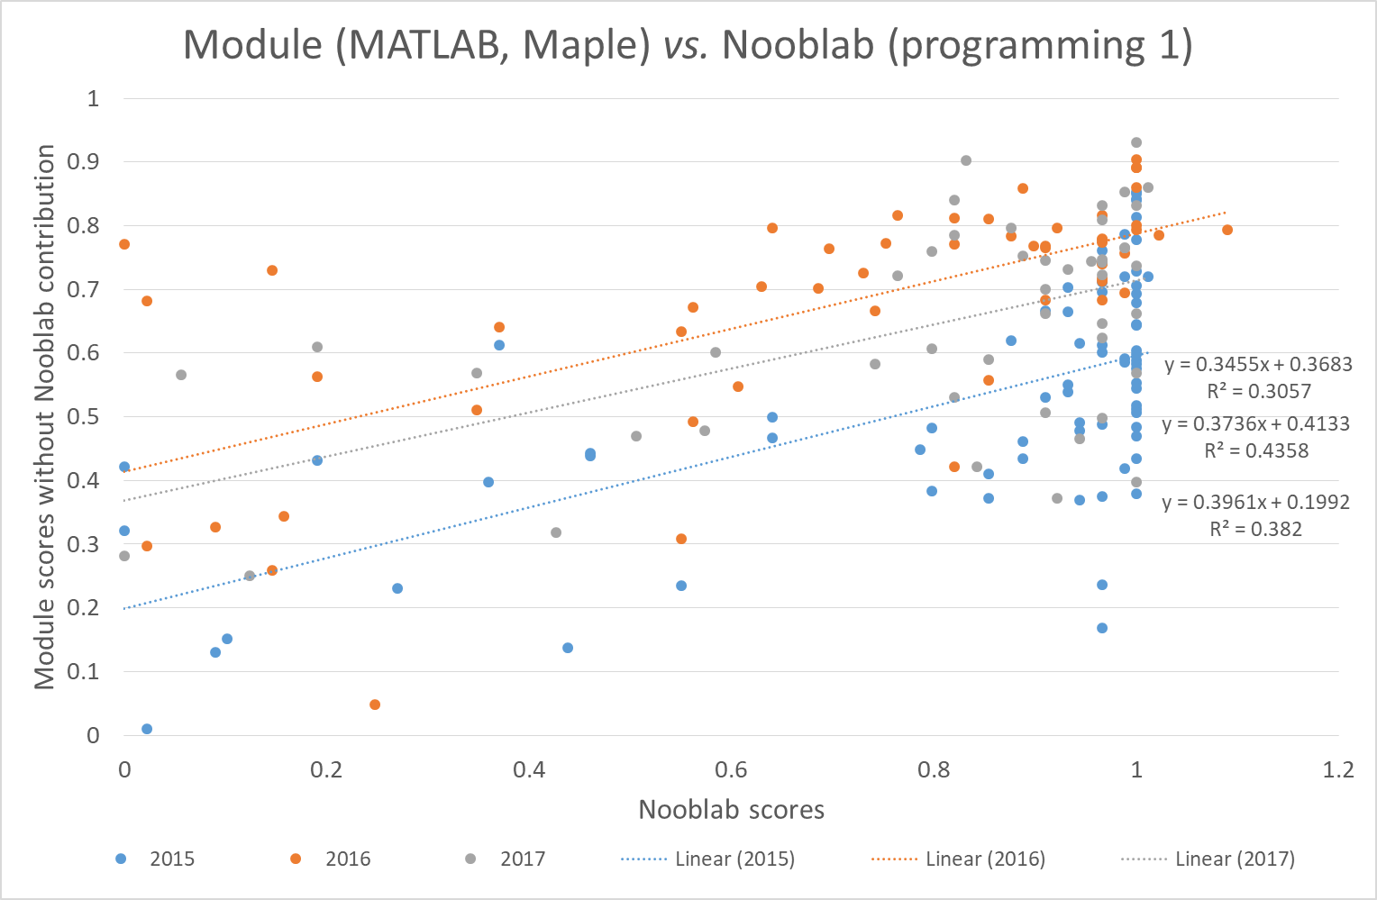
Text-based Nooblab (Carol vs. non-Carol)
2015 (n=74)
2016 (n=55)
2017 (n=47)
  Similar pattern, average module marks are down a bit
  Pass Nooblab and you tend to pass the module?

Slide 20
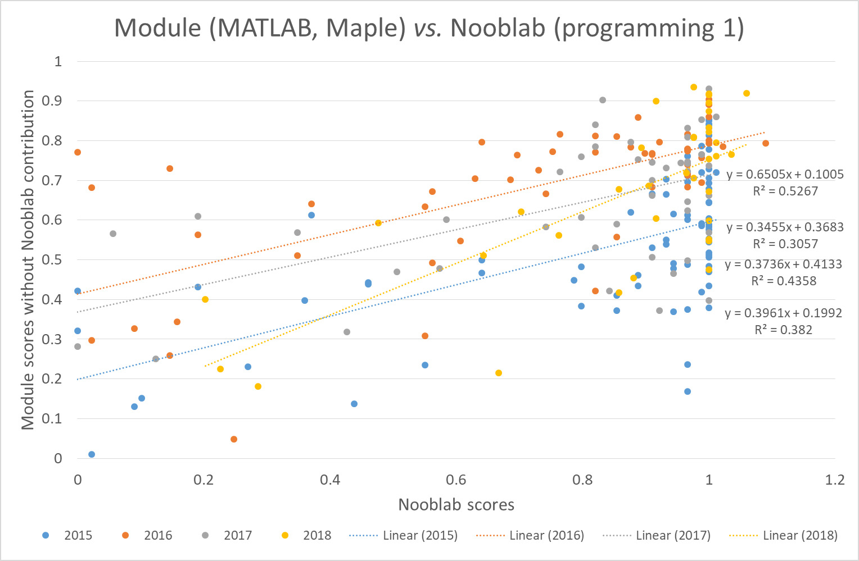
Carol works and so does non-Carol ☺
2015 (n=74)
2016 (n=55)
2017 (n=47)
2018 (n=36)
  Best-fit gradient is larger for the Carol-based Nooblab, R² is higher
  looks outlier-sensitive but maybe it’s a hint of stronger discrimination
Notes:
… but TBH I’m really just happy it’s still positively-correlated!

Slide 21
Average “computational maths” marks
Marks | Nooblab | Programming test (S) | Maple test | Programming cwk | Module
2015 | 83% | 59% | 59% | 54% | 54%
2016 | 72% | 66% | 67% | 76% | 68%
2017 | 80% | 62% | 64% | 62% | 65%
2018 | 87% | 96% | 63% | 69% | 64%
 | Nooblab | Programming test (F) | Maple cwk | Programming cwk | Module

Slide 22
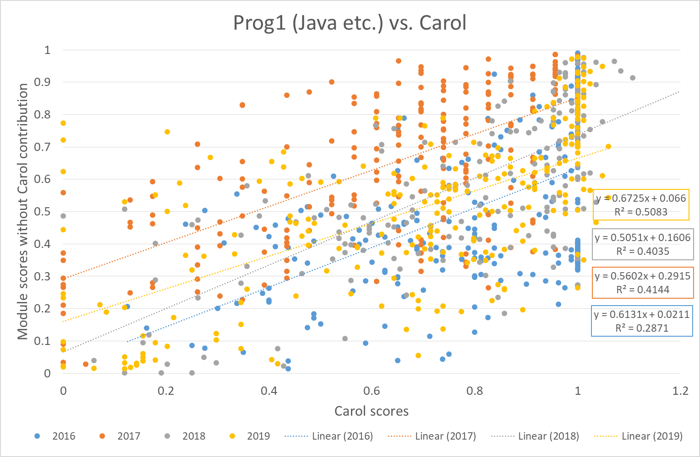
Does Carol work for CS too?
2016 | 2017 | 2018 | 2019
N=246 | N=215 | N=194 | N=246
Fairly similar pattern for non-Carol exercises in Nooblab vs. JavaScript, Java, Web combined Nooblab scores
i.e. the use of the “blocks” based Carol code to introduce programming seems effective in that it is correlated with eventual scores (within the same environment) in text-based programming

Slide 23
Extending it?
In CS there are inherent benefits in experiencing a broad set of programming languages & environments: direct employability
  Is Nooblab too friendly for 2nd year? We’ll see …
For maths would it be more beneficial to have a “core” language or is variety the spice of life here too?
  Regardless, Octave support would be nice :-)
It’s niche – whilst not a “walled garden”, Nooblab itself needs an editor for the production of exercises

Slide 24
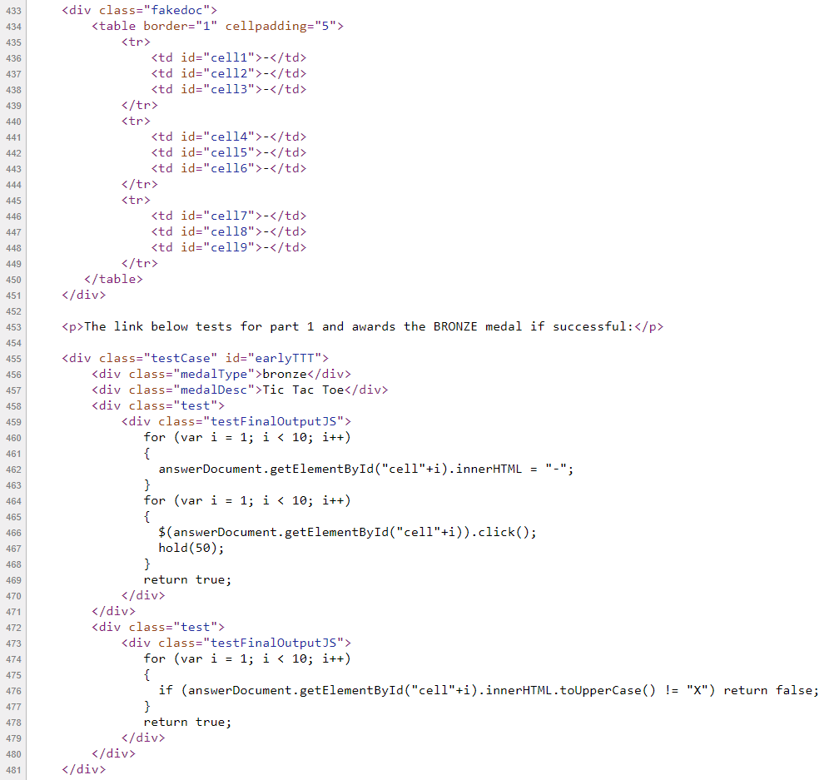
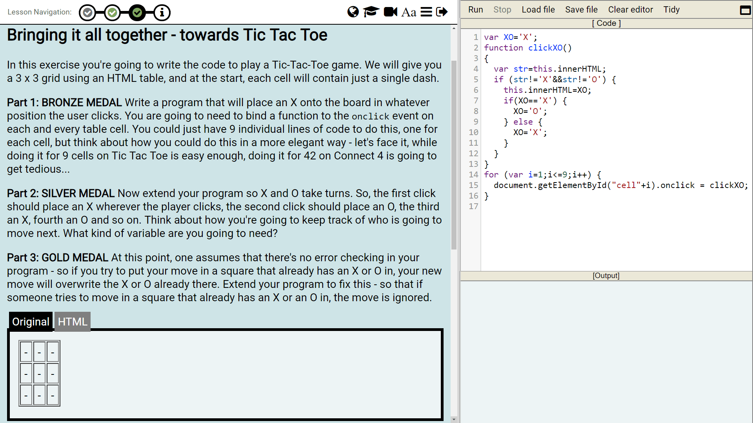
E.g. Nooblab JavaScript Tic Tac Toe

Slide 25
Sharing it?
Feel-free to drop us an email jdp@kingston.ac.uk and P.Neve@kingston.ac.uk we’d be pleased to receive suggestions and happy to discuss collaboration :-)

Slide 26
Thanks for your attention and any questions ☺
… apologies for missing the rest of the afternoon ☹
James Denholm-Price
jdp@kingston.ac.uk

Slide 27
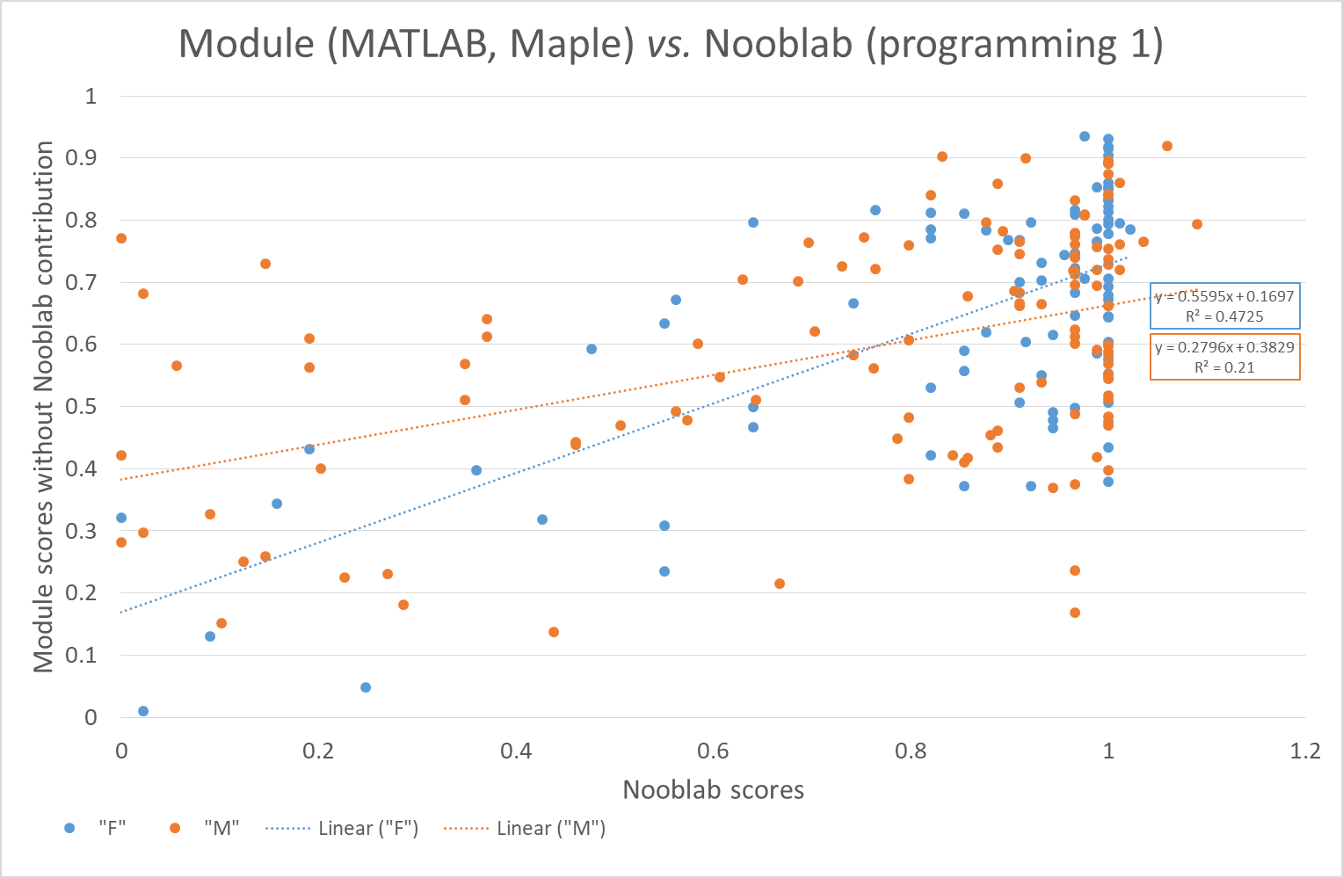
Is gender significant? Sort-of…
Quick’n’dirty analysis
  Scatter is greater for “M”
    (and we know from other studies about differences – self-efficacy etc.)
  t-test says they are (somewhat) different e.g. the mean scores in Nooblab & the other module tasks are maybe different (p=0.048) but differences are not
    i.e. (maybe) the learning gain is the same?

